Slide 1

EDAI - engineering design and innovation
DEPARTMENT OF INFORMATION TECHNOLOGY ( IT )
VISHWAKARMA INSTITUTE OF TECHNOLOGY, PUNE
REAL TIME CROWD MONITORING SYSTEM
DIV:- SY-IT-C-B3 GROUP NO:- 15
Vishwakarma Institute of Technology
PRESENTED BY:
KUNAL SONNE (12311844)
HARIOM SURWASE (12311352)
RAJ THAKUR (12310176)
SHREEPARTH TORAWANE (12311260)
ATHARVA TULJAPURKAR ( 12311652)
GUIDE:
Prof. Dr. Preeti baike Mam

Slide 2



Real Time Crowd Monitoring Project
This project dives into a real-time, that uses a camera feed to track and visualize crowd density.
Vishwakarma Institute of Technology

Slide 3
Project Overview
The Crowd Monitoring Project is an intelligent solution designed to help you understand and manage crowds effectively. It uses a camera feed to detect and count individuals in real-time, providing you with valuable insights about crowd.
This project is built on a foundation of computer vision and machine learning techniques. It leverages the power of OpenCV, an open-source library, to process images and identify people. These capabilities allow the system to provide accurate crowd statistics and visualizations.
Vishwakarma Institute of Technology

Slide 4
Problem Statement
Real-time Data Collection and Analysis: Develop a system capable of continuously collecting and processing crowd data using camera feed to monitor density, movement, and behavior in real-time.
Proactive Risk Management: Provide shopkeepers with valuable information, and visualization tools to identify and insure safety, optimize crowd flow, and improve resource allocation.
Vishwakarma Institute of Technology

Slide 5
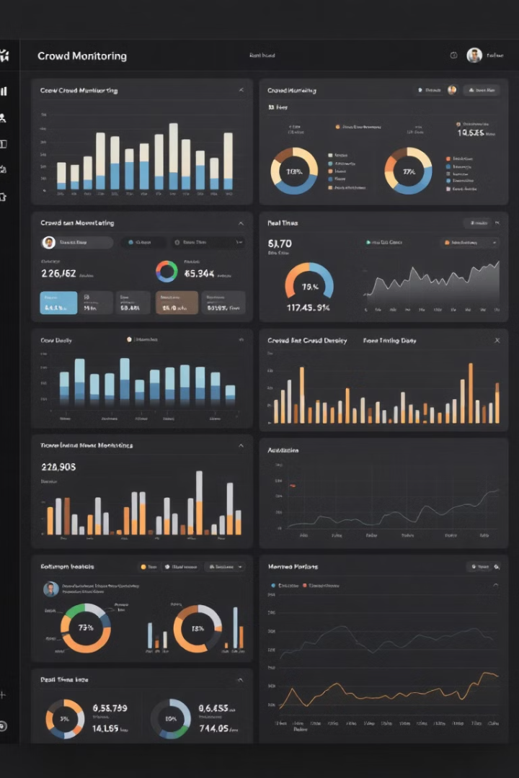
Key Features
1
People Detection
2
Configurable Coordinates
The system uses advanced computer vision techniques to accurately detect and count individuals in real-time.
You can easily define specific areas of interest within the camera's view to track crowd density in targeted locations.
Vishwakarma Institute of Technology
3
Crowd Data Visualization
4
Real-Time Monitoring
The project provides continuous, real-time updates on crowd conditions, giving you the ability to react promptly to changing situations.
The system presents crowd data in a visually engaging way on a map, allowing you to quickly understand crowd distribution and density.

Slide 6
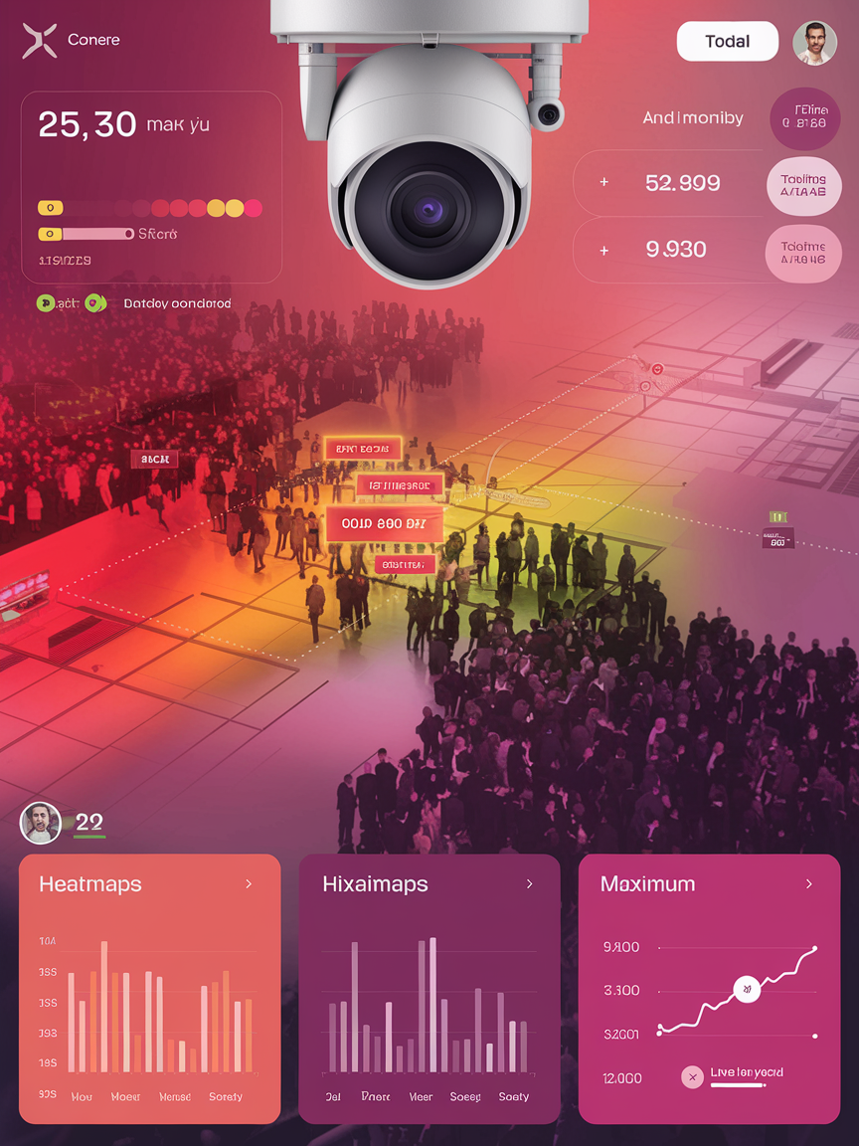
Crowd Data Visualization on Map
The system visually represents crowd data using a map interface. This allows you to quickly understand the distribution and density of people across your area of interest.
1
Vishwakarma Institute of Technology
Different colors on the map indicate varying levels of crowd density. Red areas represent high concentrations of people, while yellow areas indicate lower densities.
2
This visualization tool helps you to identify areas with high crowding and make informed decisions based on real-time data about crowd dynamics.
3

Slide 7
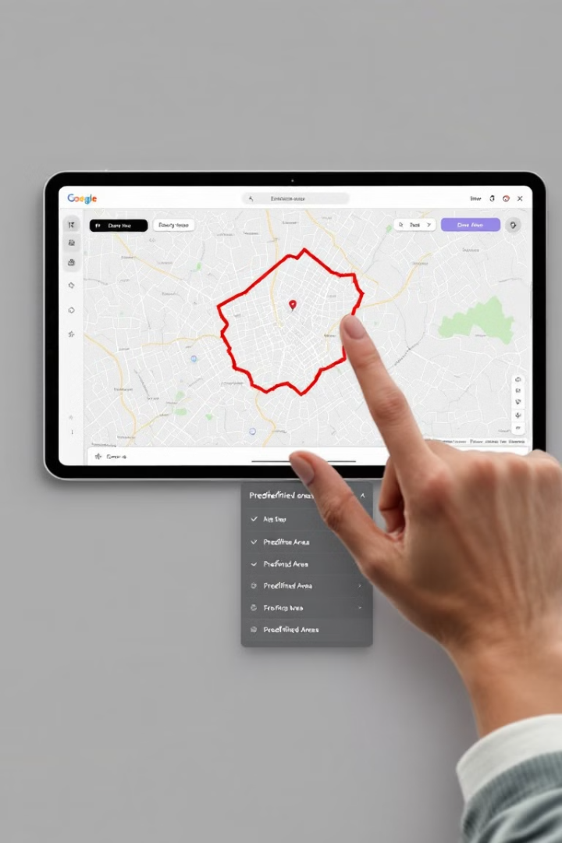



Configurable Coordinates
Area Selection
The project allows you to define specific areas of interest within the camera view, such as a particular entrance, exit, or waiting zone.
Customizable Zones
Vishwakarma Institute of Technology
Use the interactive interface to draw polygons or select predefined areas on the map to specify the regions you want to monitor closely.
Flexible Configuration
This feature provides flexibility and control over the areas you want to focus on, enabling you to track crowd density in specific locations.

Slide 8
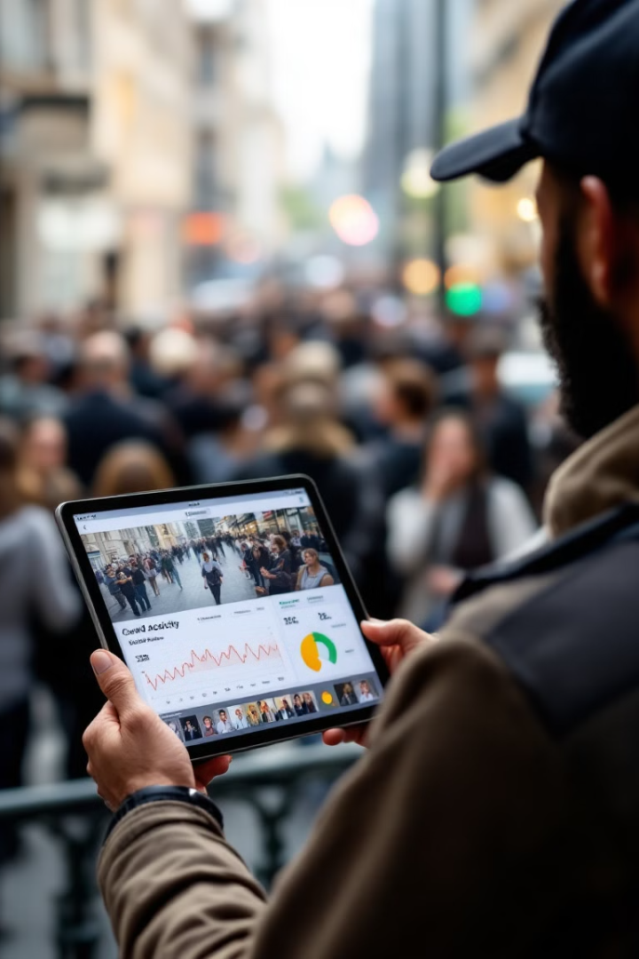



Real-Time Monitoring
Continuous Updates
The project provides real-time updates on crowd density, allowing you to monitor and react promptly to changes in crowd conditions.
Vishwakarma Institute of Technology
Adaptive Insights
This continuous monitoring capability empowers you to make informed decisions based on the latest crowd data, ensuring efficient crowd management.
Effective Response
By understanding real-time crowd dynamics, you can implement appropriate measures to address potential congestion or safety issues.

Slide 9
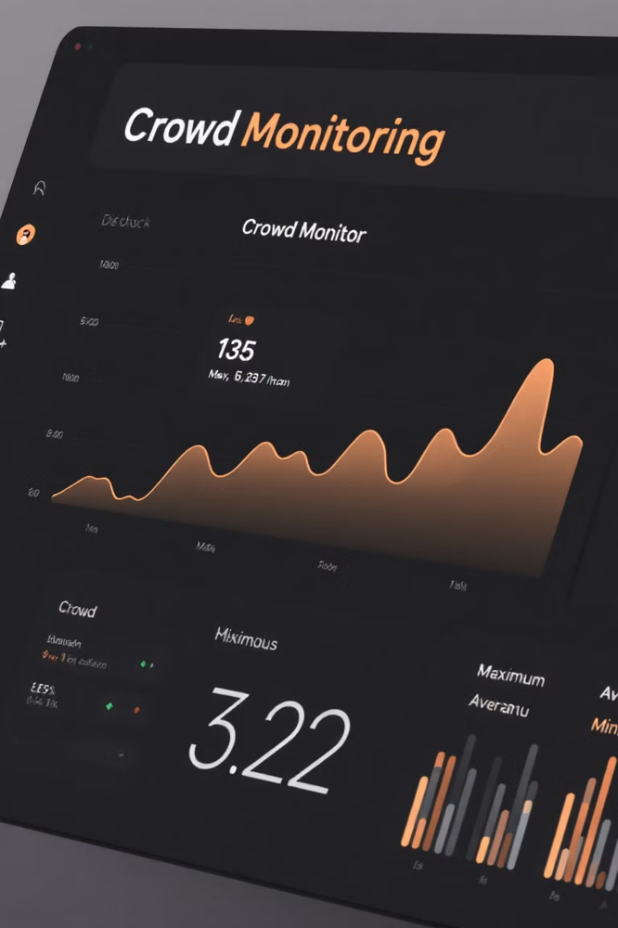
Statistics: Max, Avg, Min
20
Max
This number represents the highest crowd count recorded during the monitored period.
Vishwakarma Institute of Technology
10
Avg
The average crowd count over the monitored period provides an overall measure of the typical crowd size.
0
Min
The minimum crowd count indicates the lowest crowd density observed during the monitoring session.

Slide 10
THANK YOU

